Slide 1
Digital System Design
Group Members
1. Syed Erfan Arefin
2.Tasnia Ashrafi Heya
3. Kowshik Dipta Das Joy
4. Md. Arshad Hossain

Slide 2
Indoor Positioning System
Still A Theory for us
Voila ! Still A Dream for the Tech Lovers
But, That is what we want because we want to live in future
Lets go through the whole Presentation…

Slide 3
Indoor positioning system using voice recognition
There will be small robot which is capable of moving left-right, front-back. The user will call it by a name and the robot will reach him inside a room based on the user’s call.

Slide 4
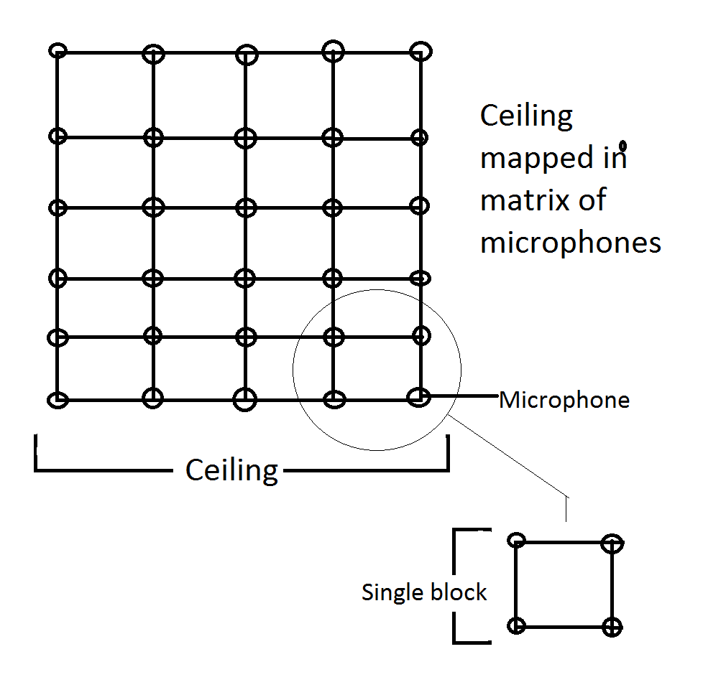
Initial Idea

Slide 5
Initial Idea
The whole ceiling will be divided into small blocks like a 2D matrix
Each block should have a microphone at every corner of each box.
When the user will call the robot, by using voice recognition we will check the level of all the blocks to determine the user’s position.
The robot will communicate with the main computer via Bluetooth to know its movement.
The robot uses encoders to determine its movement.

Slide 6
What are the tools ?
We are using windows/linux PC for central processing.
Microphone (A lot of them )
Arduino Robot which will be the voice follower connected with Bluetooth with the pc (This includes: encoder motors, tracked wheels, Arduino uno, Bluetooth hc04, servos-pan&tilt, sonar sensor-object avoidance(optional))

Slide 7
Why Do we need this ?
For medical Support
Home Assistance
All the sectors where there is a use of indoor positioning,

Slide 8
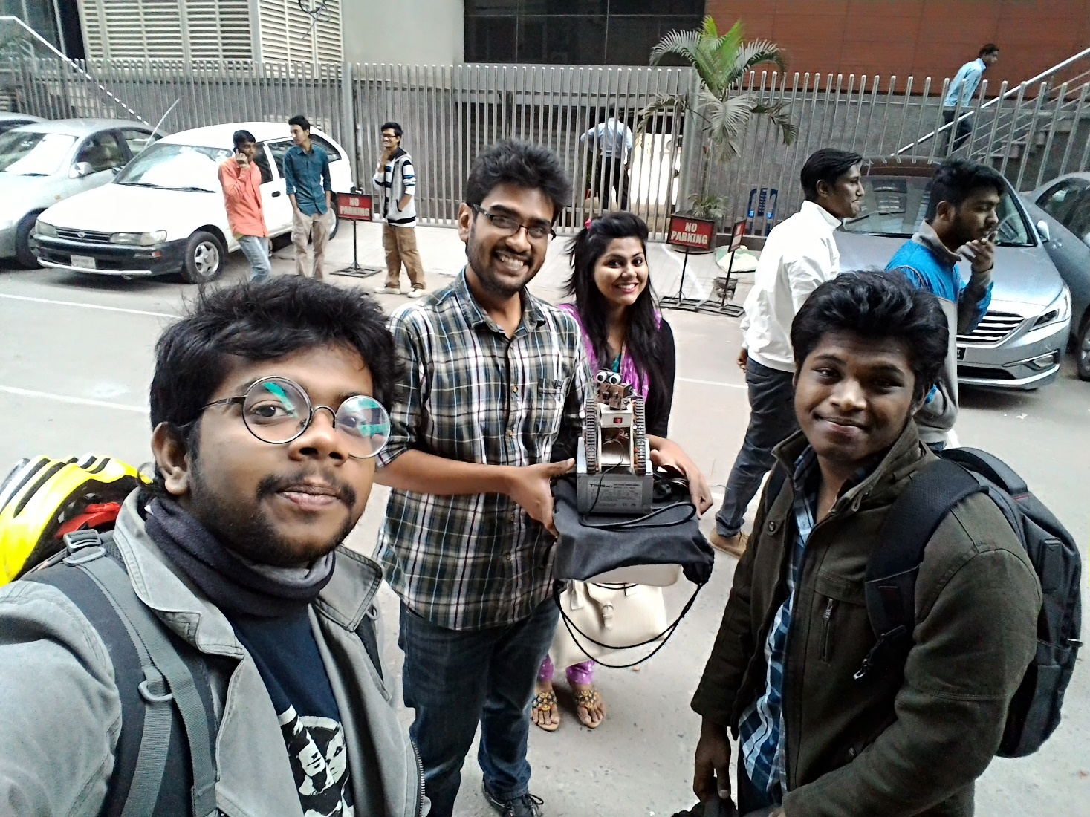
Project Prototype

Slide 9
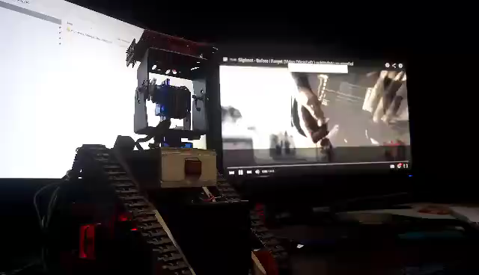
Just For Fun

Slide 10
Thank You

